Slide 1
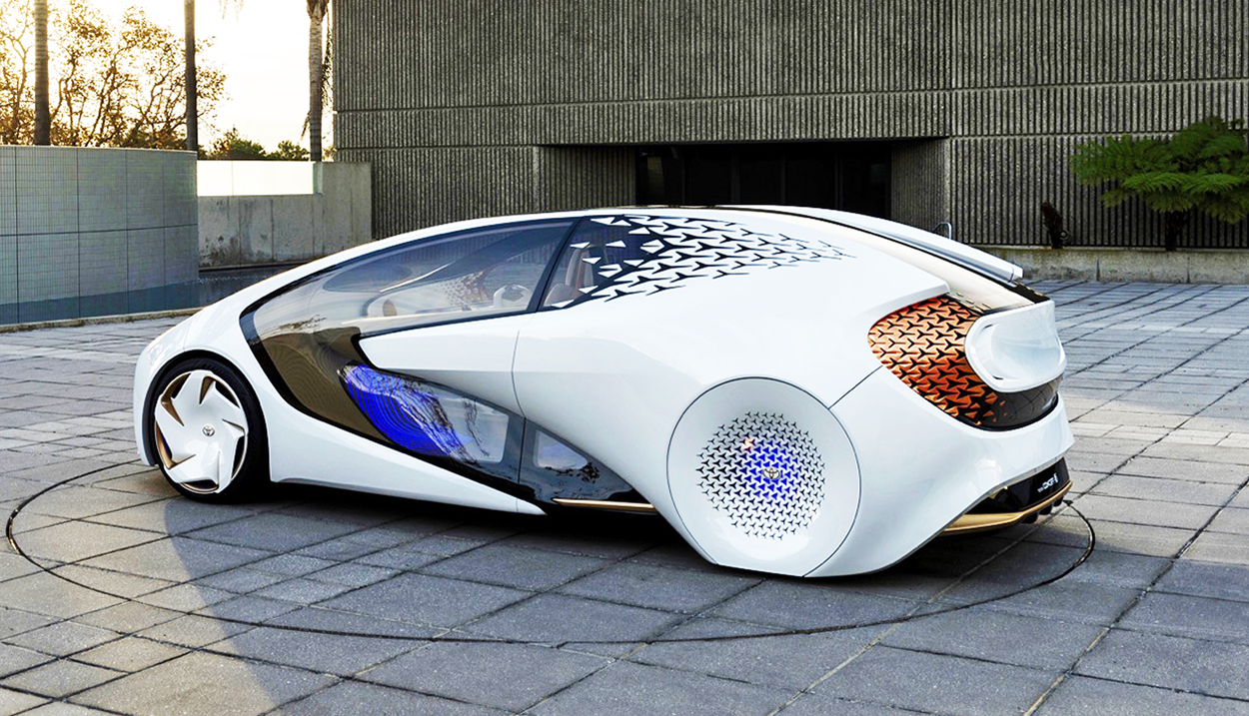
Computer Vision 2019
Build Your Own Smart Car using CNN
By Albert Choy (@askchoy)

Slide 2
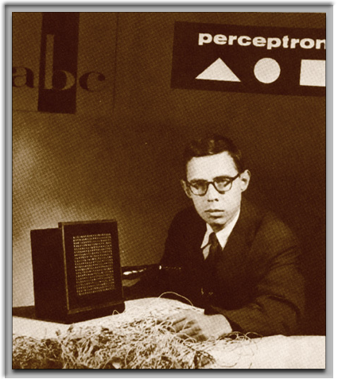
The path of Neural Networks
Theory & History
Architecture
Nuts & Bolts
Going From Here
Frank Rosenblatt, Cornell Aeronautical Labs

Slide 3
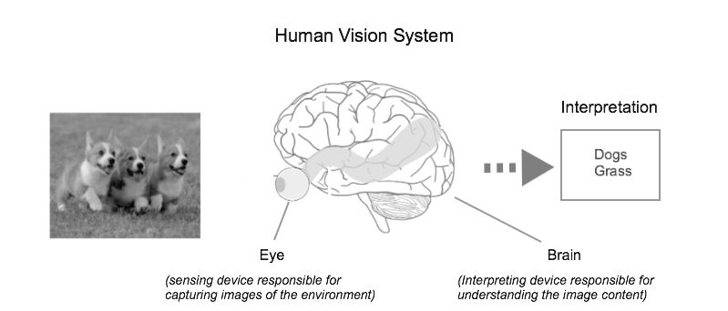

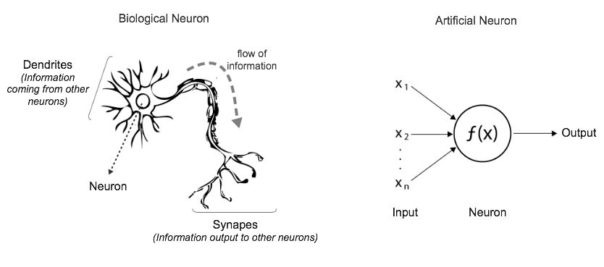
From Biological to Artificial Neural Networks
Human Vision System
Artificial Neural Networks
Biological vs. Artificial Neuron

Slide 4
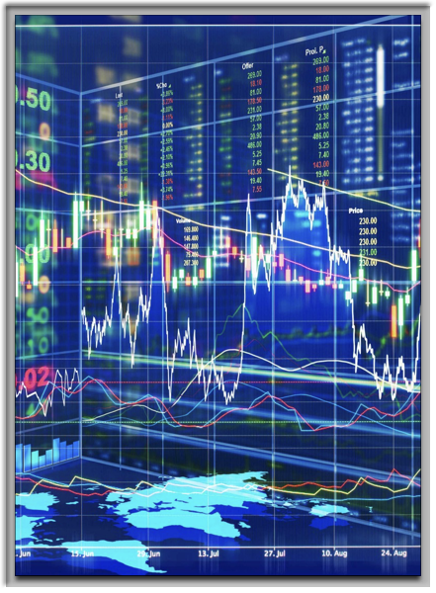
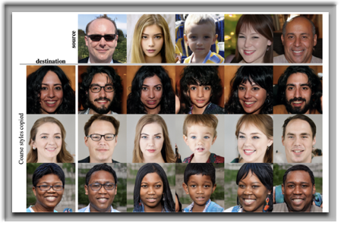
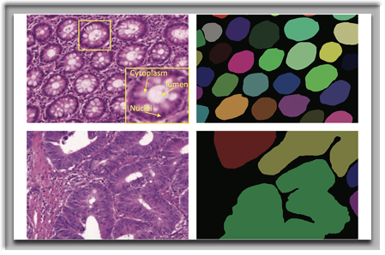
Real World NN Applications
Portfolio Trading
Fake faces
Cancer Screening

Slide 5
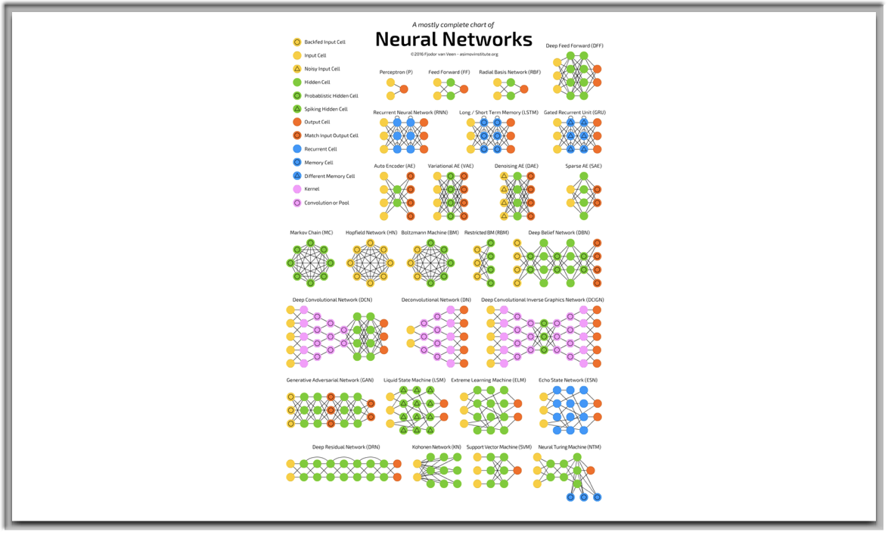
Neural Networks (eye-chart)

Slide 6
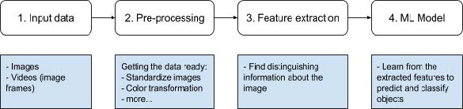
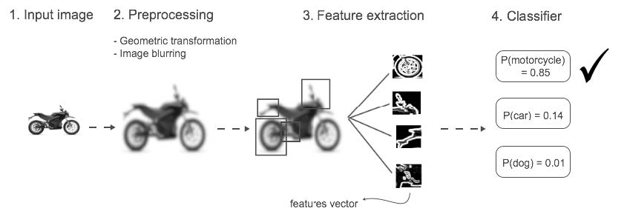
Computer Vision Pipeline

Slide 7
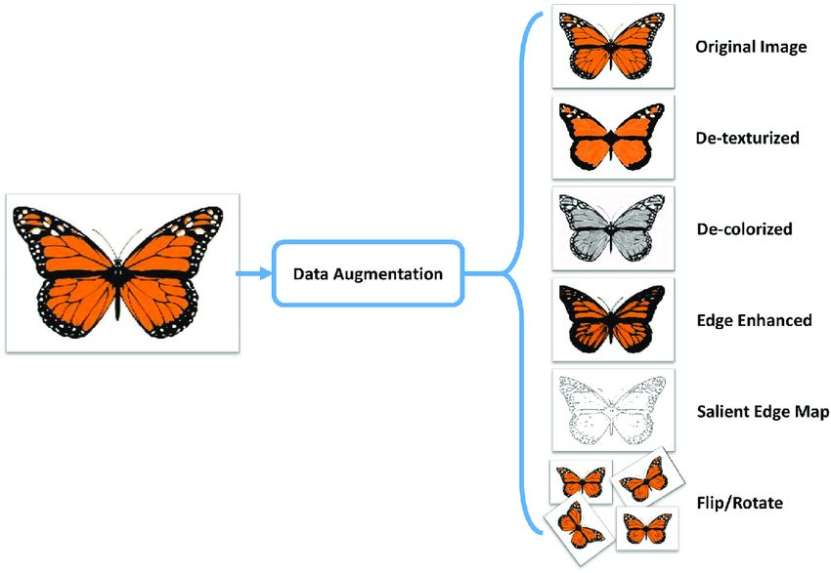
Image Preprocessing
Why?
Convert color to greyscale to reduce computation complexity.
Data augmentation
“No free lunch theorems for Optimizations”

Slide 8
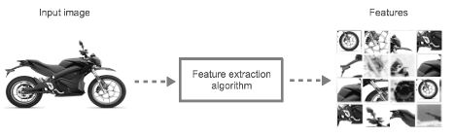
Feature extraction
Extract useful features to feed to ML for classification.
Features vector
Traditional ML uses hand-crafted features
Deep learning automatically extract features

Slide 9
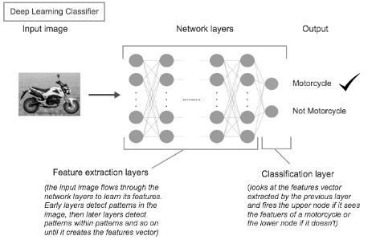
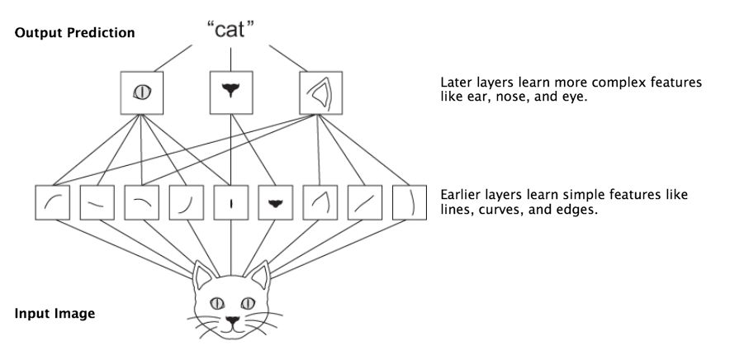
Classifier algorithms

Slide 10
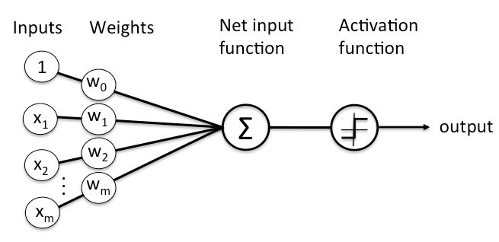
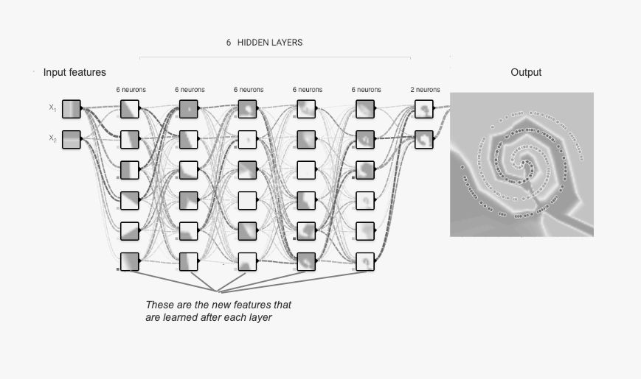
Deep Learning Architecture
Perceptron (linear function)
Multi-Layer Perceptron (MLP)
Hidden Layers
CNN

Slide 11

Convolutional NNs
Convolutional: “to convolve” or roll together. A convolution is the integral measuring how much two functions overlap as one passes over the other. Its a way of mixing two functions by multiplying them.
Convolutional networks take multiple filters (which picks up different signals over a single image) and map them one by one over an image feature space and create a map of those features.
Max pooling, downsampling and subsampling - reduce the size of feature maps
Fully connected layers for classification

Slide 12
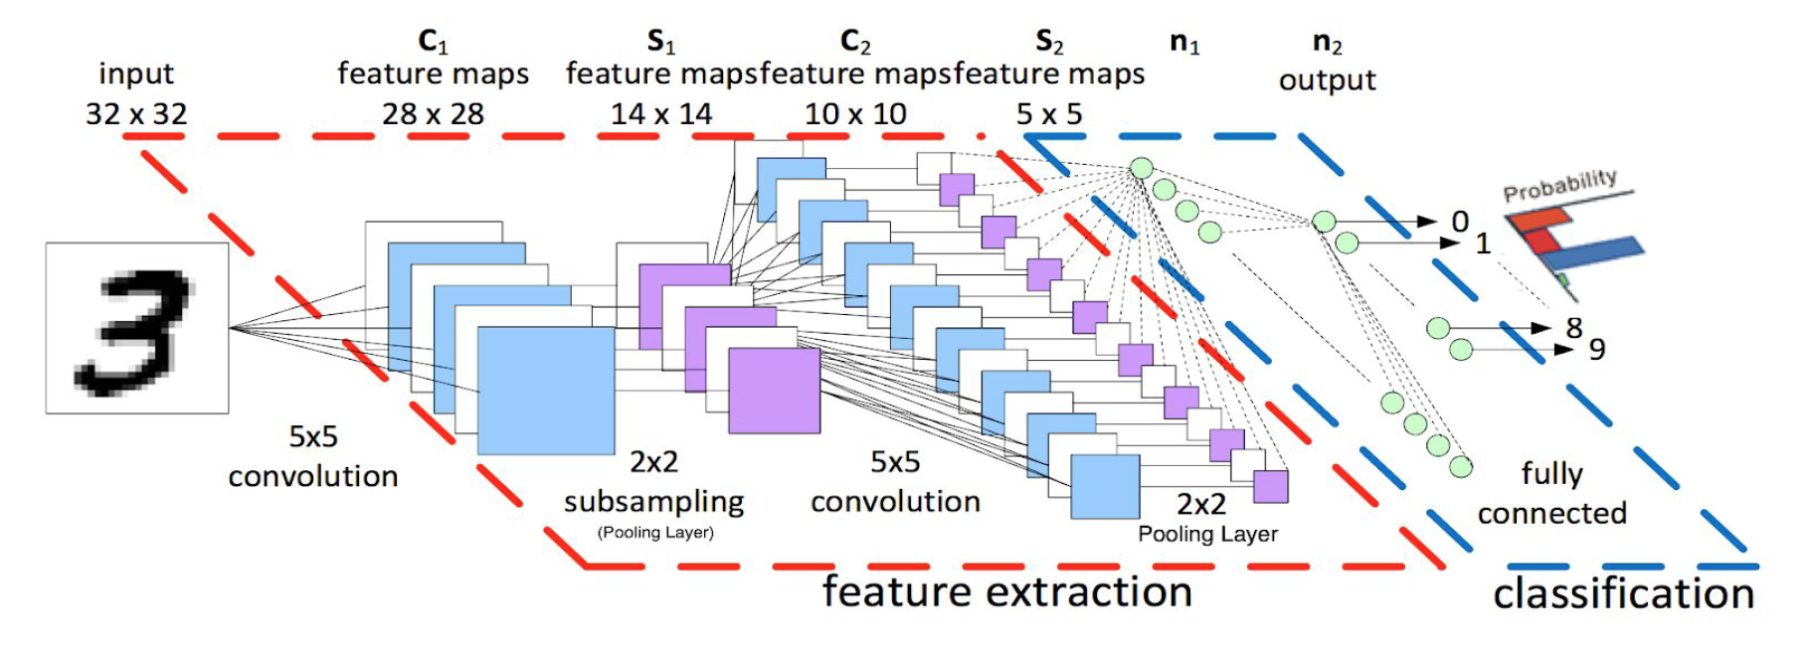
Feed raw images to input layer (32x32 or image dimensions are)
CNN layers will detect patterns and extract features -> feature maps Convolution layer [CONV], Pooling layer [POOL]
Feed features into fully connected [FC] layers for classification
CNN architecture: INPUT -> CONV -> RELU -> POOL -> CONV -> … FC -> SOFTMAX ReLU and SOFTMAX are activation functions

Slide 13
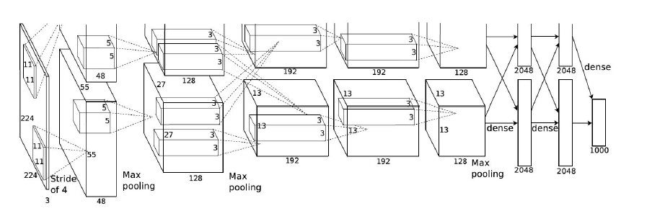
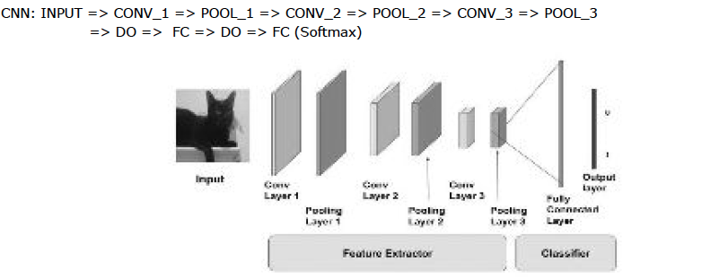
AlexNet CNN architecture: 5 CONV and POOL layers + 3 FC layers
Mini AlexNet: 3 CONV, 2 FC layers

Slide 14
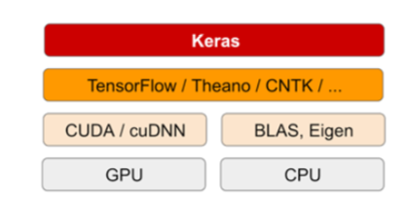
Nuts & Bolts
Exploration using Keras, Jupyter & Convolutional NNs

Slide 15
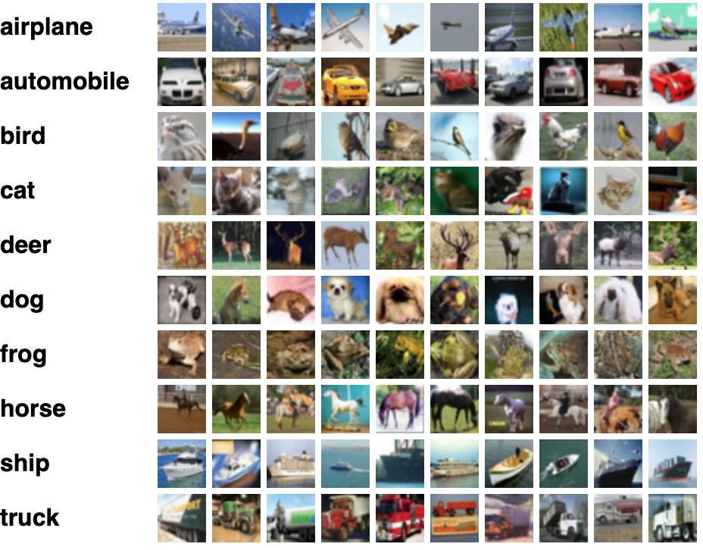
Development Environment (Linux)
Using floydhub’s (dl-docker) - docker containing ML tools (CPU and GPU versions)
Keras library
Jupyter notebook (UI)
achoy/vision-talk @ GitHub
Development Environment (Mac & Linux)
Anaconda Distribution
CIFAR-10
https://www.cs.toronto.edu/~kriz/cifar.html

Slide 16
“Enough! Now for some *** code”
– A. Choy

Slide 17
Recipe: Computer Vision Hot-dish
0) Input data
1) Flatten the input images (if necessary)
2) Build CNN: design layers
Convolutional layer, pooling (subsampling) layer, FC (fully connected) layers
3) Add dropout layers to avoid overfitting
4) CNN Hyperparameters
5) Train
6) Use your CNN

Slide 18
Tuning hyperparameters
Kernel size: matrix of weights that slides over the image to extract features. CONV filter (width x height) 2x2 to 5x5
Learning rate controls how much to update the weights in the optimization algorithms.
Number of epochs is the number of times the entire training set pass through the neural networks. Increase epochs until we see the smallest gap between test and training error.
Batch size: 16 to 128. CNN is sensitive to batch size.
Activation function: introduces non-linearity to the model - rectifier, sigmoid, tanh depending on task.
Hidden layers and units - add layers until test error no longer improves

Slide 19
Tuning hyperparameters
Weight initialization - add small random number to prevent dead neurons, but not too small to avoid zero gradient.
Dropout for regularization Dropout is a preferable regularization technique to avoid overfitting in deep neural networks. The method simply drops out units in neural network according to the desired probability. A default value of 0.5 is a good choice to test with.
Grid search or randomized search
Use genetic algorithm to optimize hyper parameters
Visualization
Look at activations and weights
Well-trained networks usually have nice and smooth filters without any noisy patterns.

Slide 20
References
#1: Grokking Deep Learning for Computer Vision by Mohamed Algendy (Manning) www.computervisionbook.com
Deep Learning with Python by Francois Chollet (Manning)
https://mitpress.mit.edu/books/parallel-distributed-processing-volume-1
https://towardsdatascience.com/a-walkthrough-of-convolutional-neural-network-7f474f91d7bd
https://skymind.ai/wiki/convolutional-network
https://www.theverge.com/2018/12/17/18144356/ai-image-generation-fake-faces-people-nvidia-generative-adversarial-networks-gans
Keras (keras.io)

Slide 21
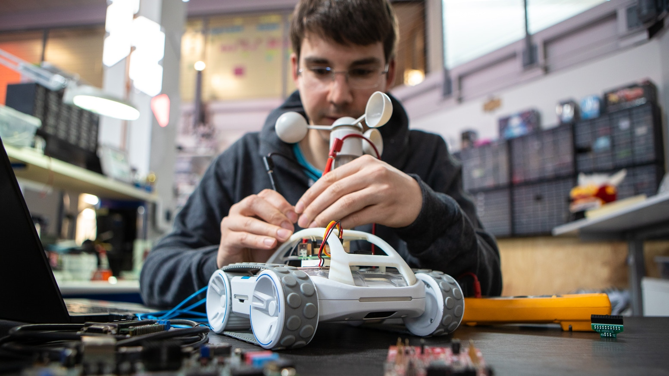
Sphero RVR - Next Year’s Talk

Slide 22
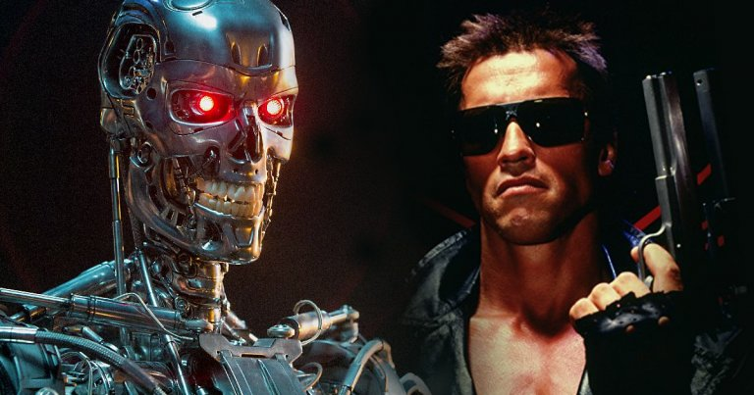
Not recommended.

Slide 23
MLP and CNNs
Weights and biases
Hyperparameters: error function, activation function, and optimizer
Training
Use the NN …
(Equip your car with computer vision)

